Slide 1

RG

Slide 2
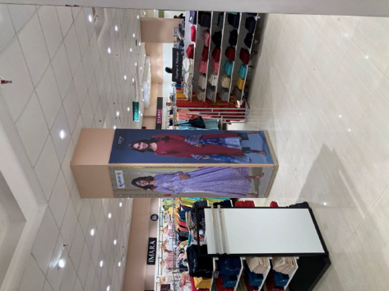
Uploaded
Latur | Eco Solvent Self adhesive vinyl with matt lamination | 75FFFL1 | 30.5 | 96 | Kashish

Slide 3

Latur | 75FFFL2 | Eco Solvent Self adhesive vinyl with matt lamination | 30.5 | 96

Slide 4

Latur | 75FFFL4 | Eco Solvent Self adhesive vinyl with matt lamination | 30.5 | 96

Slide 5

Latur | 75FFFL6 | Eco Solvent Self adhesive vinyl with matt lamination | 30.5 | 96

Slide 6

Latur | 75FFFL7 | Eco Solvent Self adhesive vinyl with matt lamination | 30.5 | 96

Slide 7

Uploaded
Latur | 75FFFL1 | Eco Solvent Self adhesive vinyl with matt lamination | 30.5 | 96

Slide 8

Latur | 75FFFL11 | Eco Solvent Self adhesive vinyl with matt lamination | 35 | 91

Slide 9
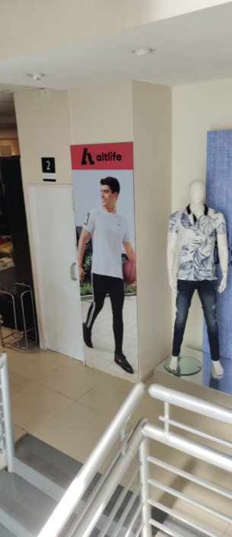
Latur | 75SFL1 | Eco Solvent Self adhesive vinyl with matt lamination | 30 | 96

Slide 10

Latur | 75TFFL1 | Eco Solvent Self adhesive vinyl with matt lamination | 30.5 | 96

Slide 11
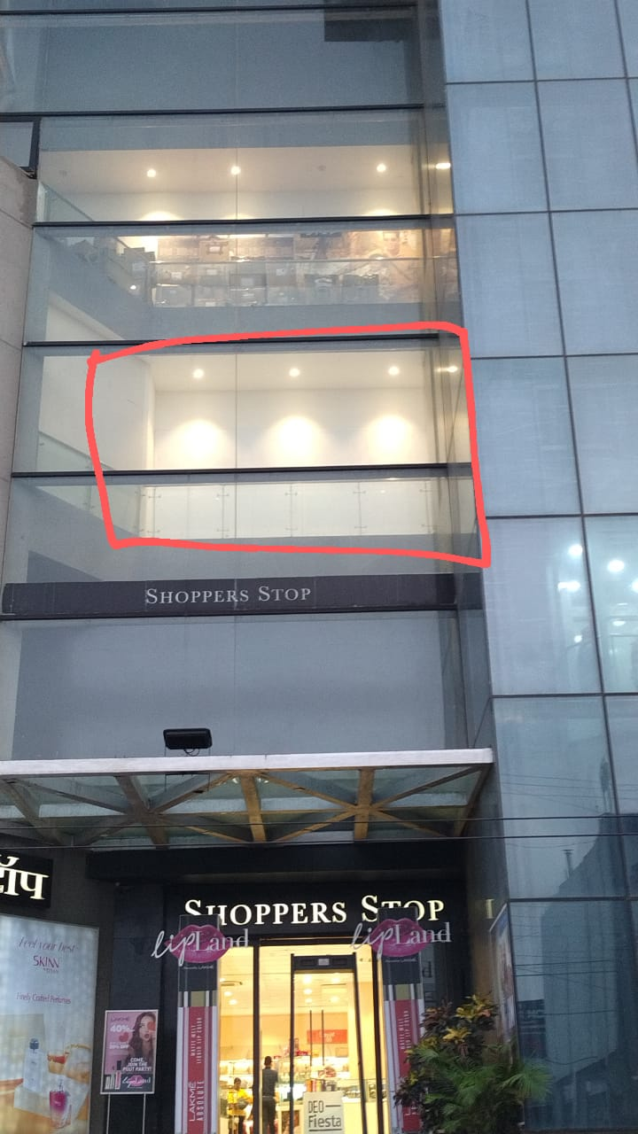

Uploaded
WINDOW
GB vinyl - File made in two parts

